Slide 1
Malaria Elimination
In the Americas
The role of primary healthcare providers
Paramaribo, November 23rd 2024

Slide 2
Malaria Elimination Essential Glossary
Malaria elimination: Interruption of local transmission (zero indigenous cases) of all human malaria parasites in a defined geographical area.
Malaria eradication: Permanent reduction to zero of worldwide incidence of infection caused by all human malaria parasites.
Malaria reintroduction: Occurrence of introduced cases in a country or area where malaria had been eliminated.
Malaria transmission re-establishment: Renewed presence of locally acquired malaria infection due to repeated cycles of mosquito-borne infections in an area where transmission had been interrupted.
Malaria suspected case: An individual who a healthcare worker (institutional or community) infers is likely to be a malaria case based on symptoms and/or origin place (travel history).
Malaria confirmed case: A suspected case confirmed by a parasitological test (microscopy or RDT).
Case investigation: Collection of information to allow the proper classification of a malaria case.
Imported case: A confirmed case in which the patient acquired the infection outside the area where it was diagnosed (usually in another country).
Introduced case: A confirmed case contracted locally, with strong epidemiological evidence linking it directly to a known imported case (first-generation local transmission).
Indigenous case: A confirmed case contracted locally with no evidence of importation or direct link to transmission from an imported case.
World Health Organization (WHO). 2021 update. WHO malaria terminology. Geneva. Licence: CC BY-NC-SA 3.0 IGO.

Slide 3
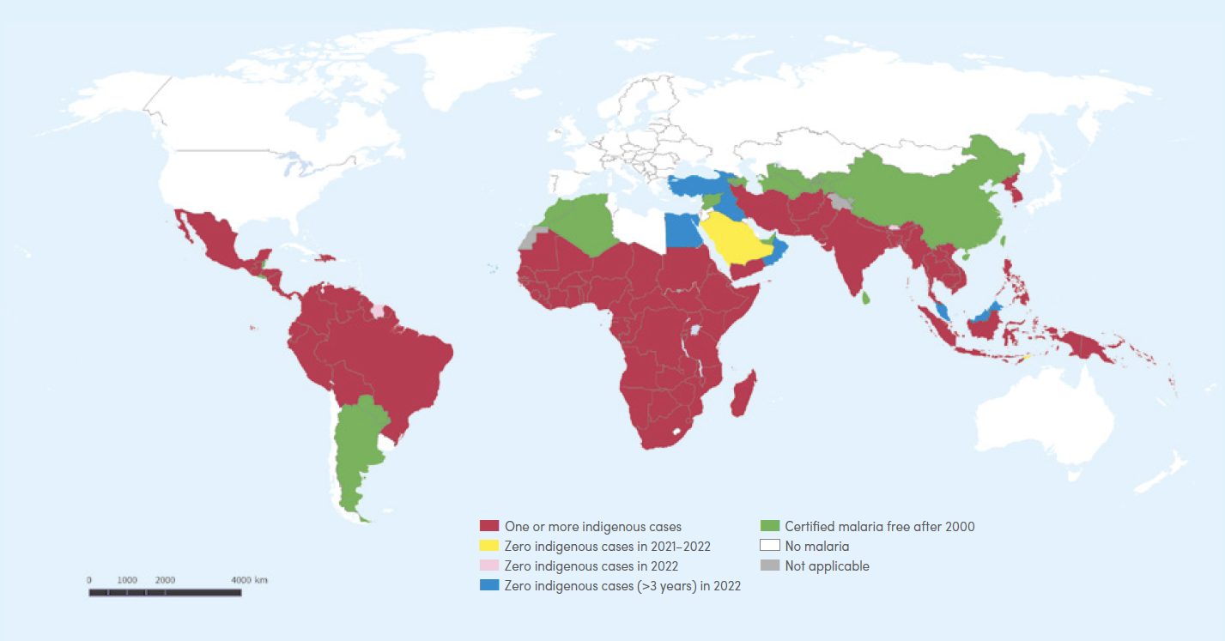
Countries with indigenous malaria cases in 2000 and their status by 2022
World Health Organization (WHO). World Malaria Report 2023.

Slide 4
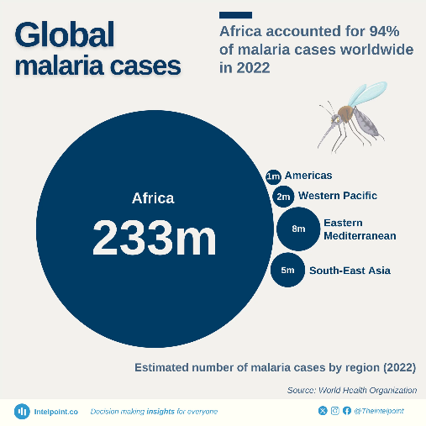
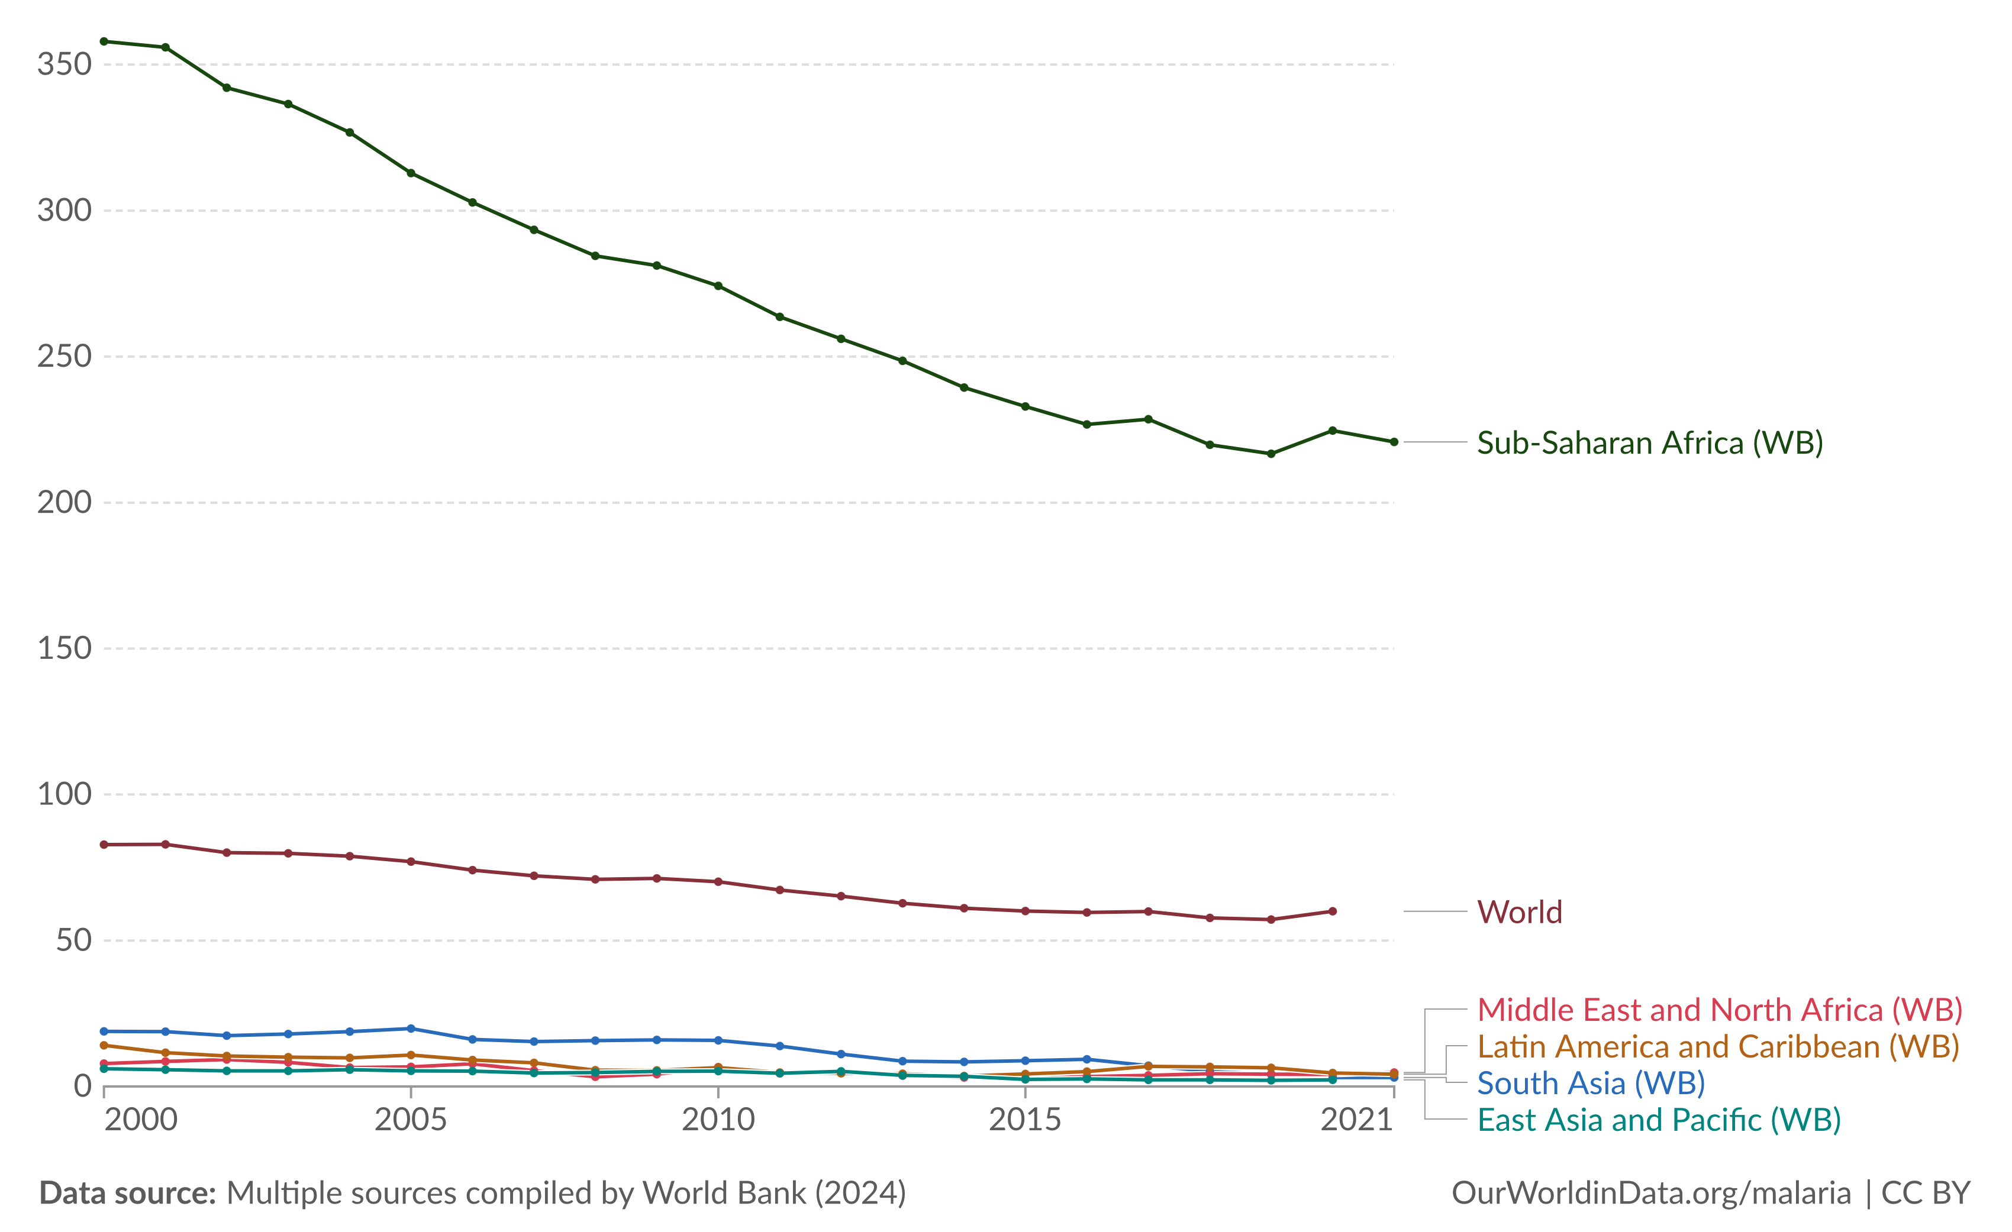
Malaria burden per World region, 2022
482,000 cases
(0.2% of global cases)
Number of malaria cases per year per 1,000 population at risk, 2000-2021
World Health Organization (WHO). World Malaria Report 2023 data.

Slide 5
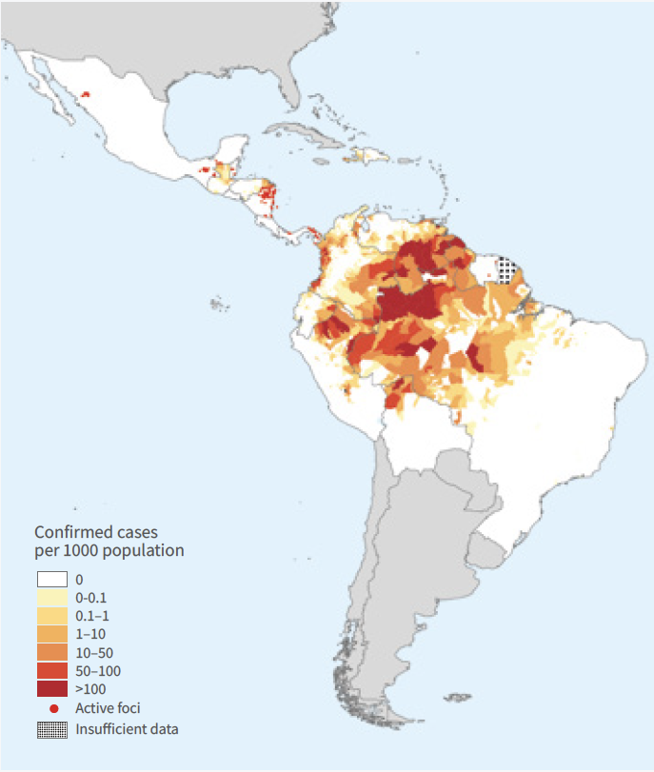
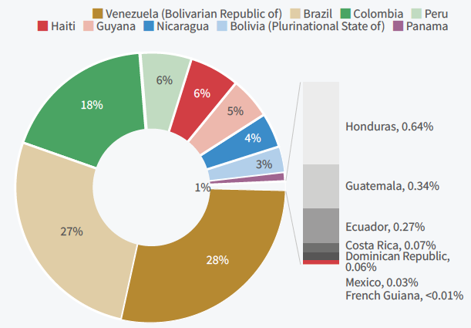
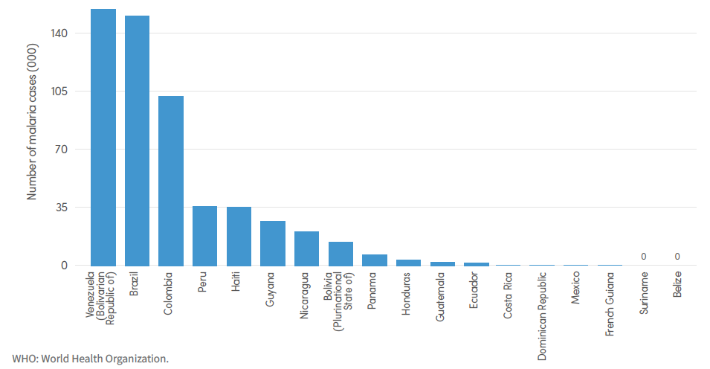
Malaria cases distribution in the Americas, 2022
Confirmed malaria cases per 1000 population, 2022
Share of estimated malaria cases per country, 2022
Number of malaria cases in the Americas region, per country, 2022
World Health Organization (WHO). World Malaria Report 2023.

Slide 6
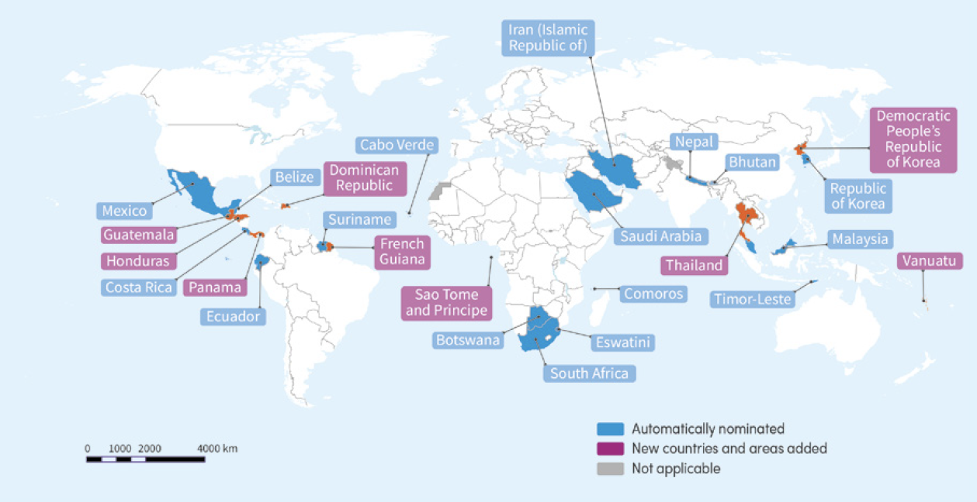
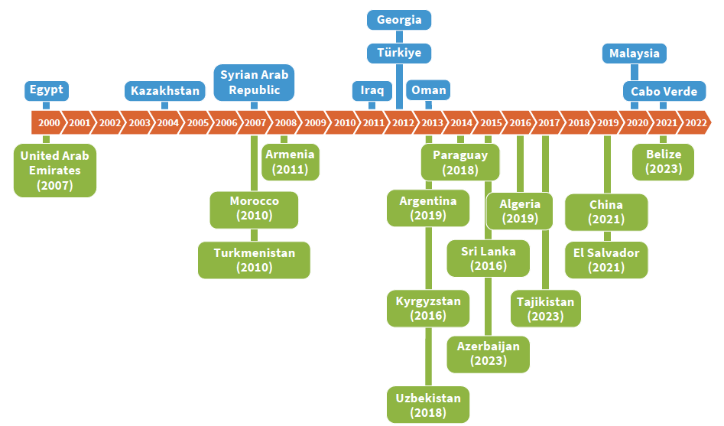
Countries certified as malaria-free and the next candidates
25 Countries and areas selected for the WHO E-2025 initiative
Countries eliminating malaria since 2000
World Health Organization (WHO). World Malaria Report 2023.

Slide 7
WHO requirements for malaria elimination certification
Local malaria transmission by Anopheles mosquitoes has been fully interrupted, resulting in zero incidence of indigenous cases for at least the past three (3) consecutive years.
An adequate surveillance and response system for preventing re-establishment of indigenous transmission is fully functional (in particular the curative and preventive services and the epidemiological service) throughout the territory of the country.
World Health Organization (WHO). 2017. A framework for malaria elimination. Geneva. Licence: CC BY-NC-SA 3.0 IGO.

Slide 8
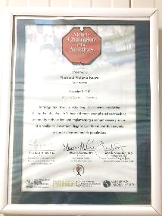
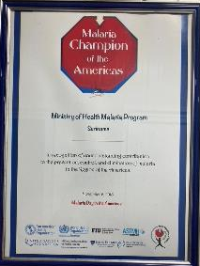
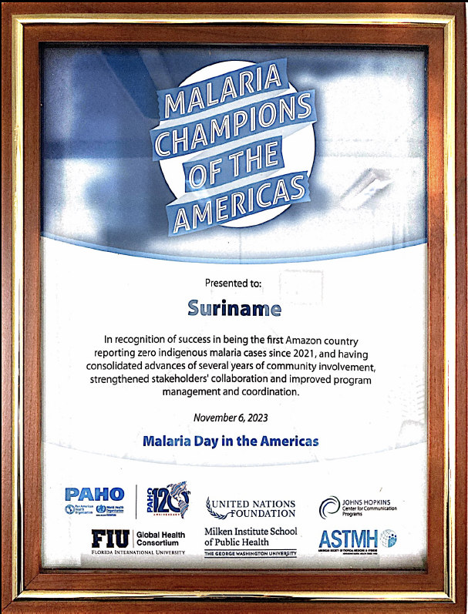
Suriname malaria elimination current status
The country completed three years without local transmission (the last indigenous case occurred in October 2021).
The aim is to prevent reintroduction and local transmission re-establishment.
The WHO certification visit is expected in 2025, during the first semester.
In the post-elimination phase, the main surveillance action is to detect imported cases as early as possible.

Slide 9
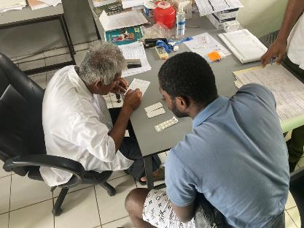
The role of primary healthcare providers in malaria elimination
Malaria is a disease that can be quickly confirmed and completely cured.
Parasite importation risk remains high in the country (due to human mobility).
It is impossible to prevent human movement or imported cases, but having a high suspicion level is essential.
Primary healthcare providers are usually the first contact with suspected cases (people with malaria symptoms and/or coming from endemic areas).
Must follow the DTI-R strategy every day with every patient.

Slide 10

DTI-R strategy to eliminate malaria in the Americas
Suspicion
DIAGNOSIS
within 48 hours
from symptoms onset
TREATMENT
On the same day of
diagnosis
RESPONSE
Detection of additional cases
within the first 7 days from diagnosis
Suspected cases
INVESTIGATION
Case investigation and classification within 3 days from diagnosis
Microscopy or RDT
Start of treatment
Reactive Case
Detection (RACD)
Suspicion

Slide 11
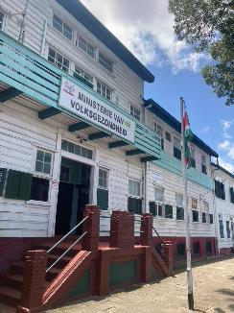
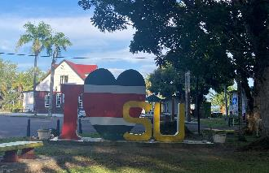
Conclusions
Malaria is a human disease (humans are the only reservoir of malaria parasites).
Accurate, quick, non-expensive, and easy-to-use confirmatory diagnosis tools (RDT) are widely available.
Antimalarial medications are curative, stable, well-tolerated, and cost-effective.
Therefore, elimination is a feasible goal.
Primary healthcare workers are the country’s first line of defense in detecting imported cases promptly.

